Slide 1
Temporal Trends in Carbon Cycling
Caitlin Hicks Pries
and the members of the Carbon Temporal Synthesis Group (in no particular order):
Sophie von Fromm, Angela Possinger, Chris Solomon, Andrew Reinman, Heili Lowman, Peter Groffman, Emerson Conrad Rooney, Jason Demers, Geoff Wilson, Bob Fahey, Jeff Garnas, Pam Templer, Darby Bergyl, Scott Olinger, Nina Lany, and Alix Contosta

Slide 2

How has global change affected the carbon cycle at Hubbard Brook?

Slide 3
Some Background
This effort came out of the Carbon Cycle workshop in January
We want to find a way to synthesize the myriad of long-term data products related to the carbon cycle
There are many projects examining temporal trends at Hubbard Brook, but we *think* this is the only one focused on connecting all of the carbon cycle-related data

Slide 4
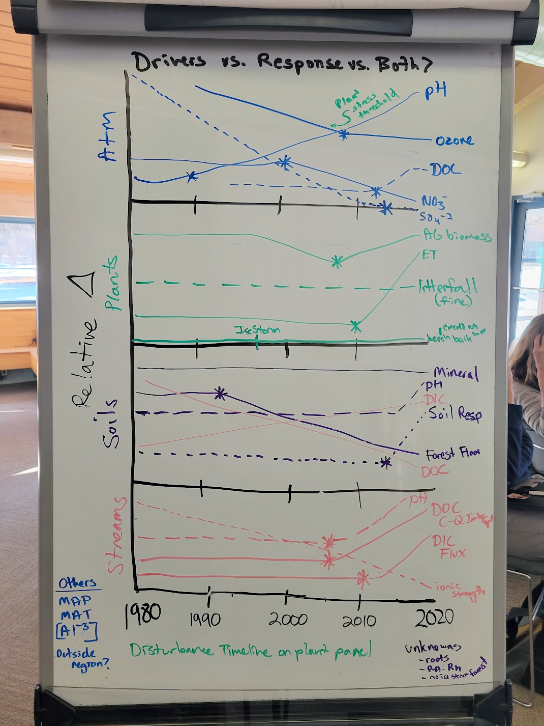
What is the rate and direction of change of carbon-related parameters in streams, plants, and soils over the past ~30-40 years at Hubbard Brook? Are these changes gradual or abrupt?
How do these trends compare to changes in drivers?
Notes:
Can we use comparisons between watershed 1 and watershed 6 to tease apart climate vs atmospheric chemistry drivers?
Standardized change

Slide 5
Preliminary Hypothesis:
There is an interaction wherein the responses of carbon fluxes (inputs and outputs) to climate change are more pronounced after a certain threshold of recovery from the effects of acid rain is reached.

Slide 6

Approach
Graph all of the potentially relevant datasets!
Standardized analyses of the temporal datasets:
Is it changing?
Is there a linear trend? Positive or negative? What is the (standardized) slope?
How it is nonlinear?
Does it have a breakpoint?
Unresolved:
Can we use comparisons between WS 1 and WS 6 to tease apart climate vs atmospheric chemistry drivers?
What about elevational gradients?
Notes:
According to hypothesis, we would expect larger responses in WS1 than in WS6

Slide 7

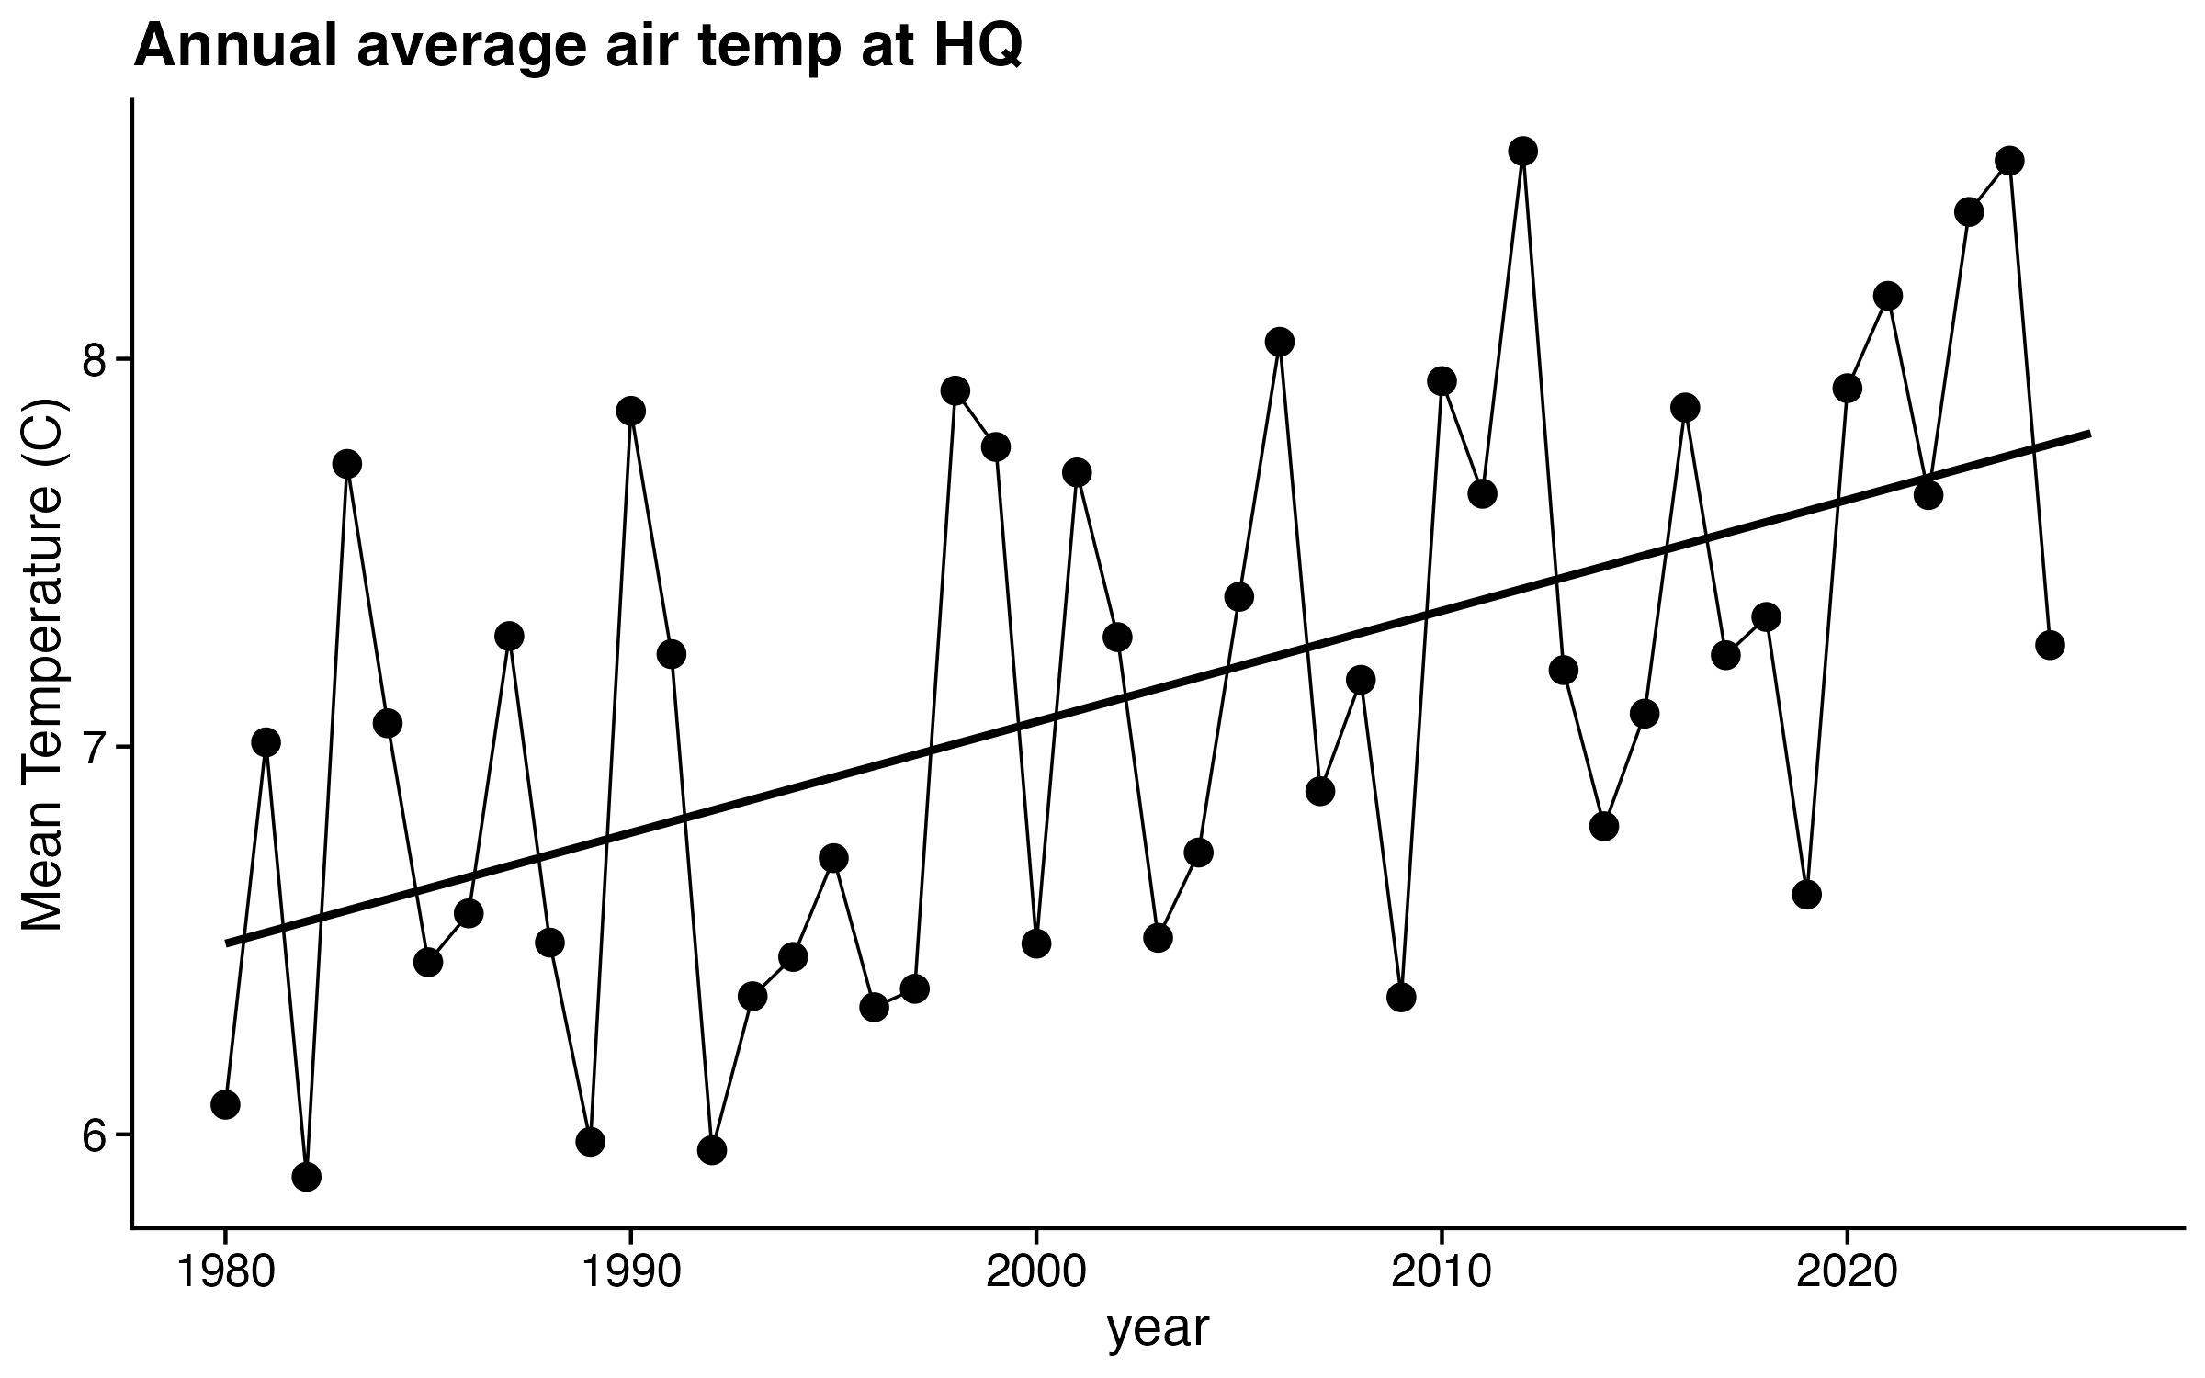
Climate Driver
Slope = 0.0286 °C year⁻¹
Standardized slope = 0.5352

Slide 8

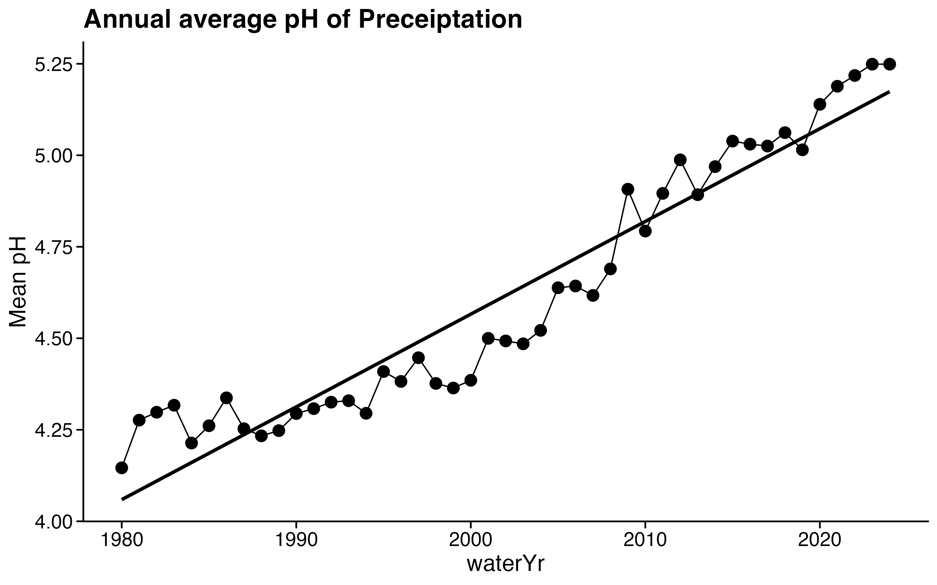
Atmospheric Chemistry Driver
Slope = 0.0253 pH units year⁻¹
Standardized slope = 0.9579

Slide 9
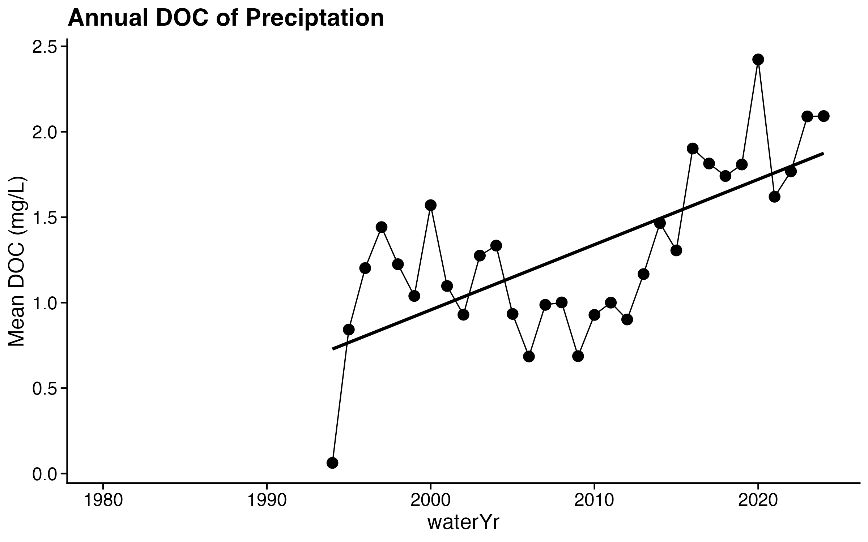
Atmospheric Carbon
Slope = 0.03812 mg/L year⁻¹
Standardized slope = 1.001
Notes:
Are these zeroes actually zeroes?

Slide 10

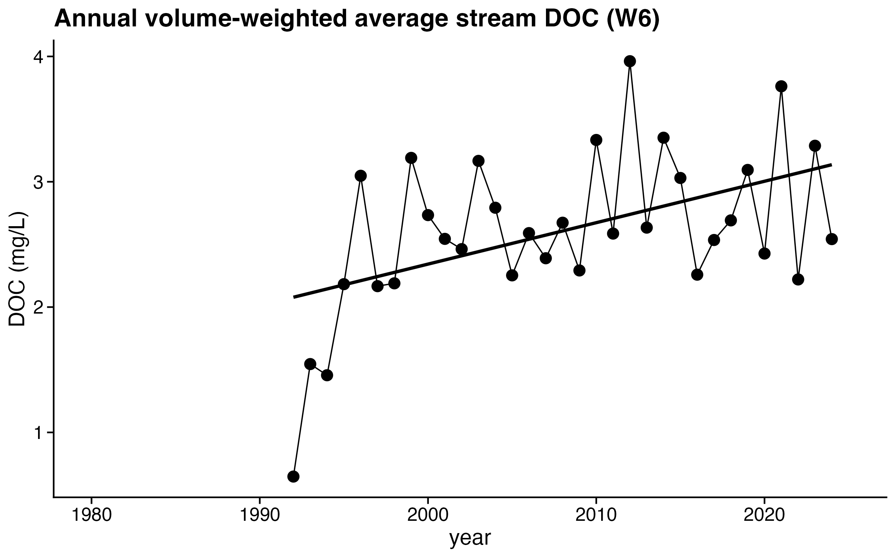
Stream Response
Slope = 0.0331 mg/L year⁻¹
Standardized slope = 0.6833

Slide 11
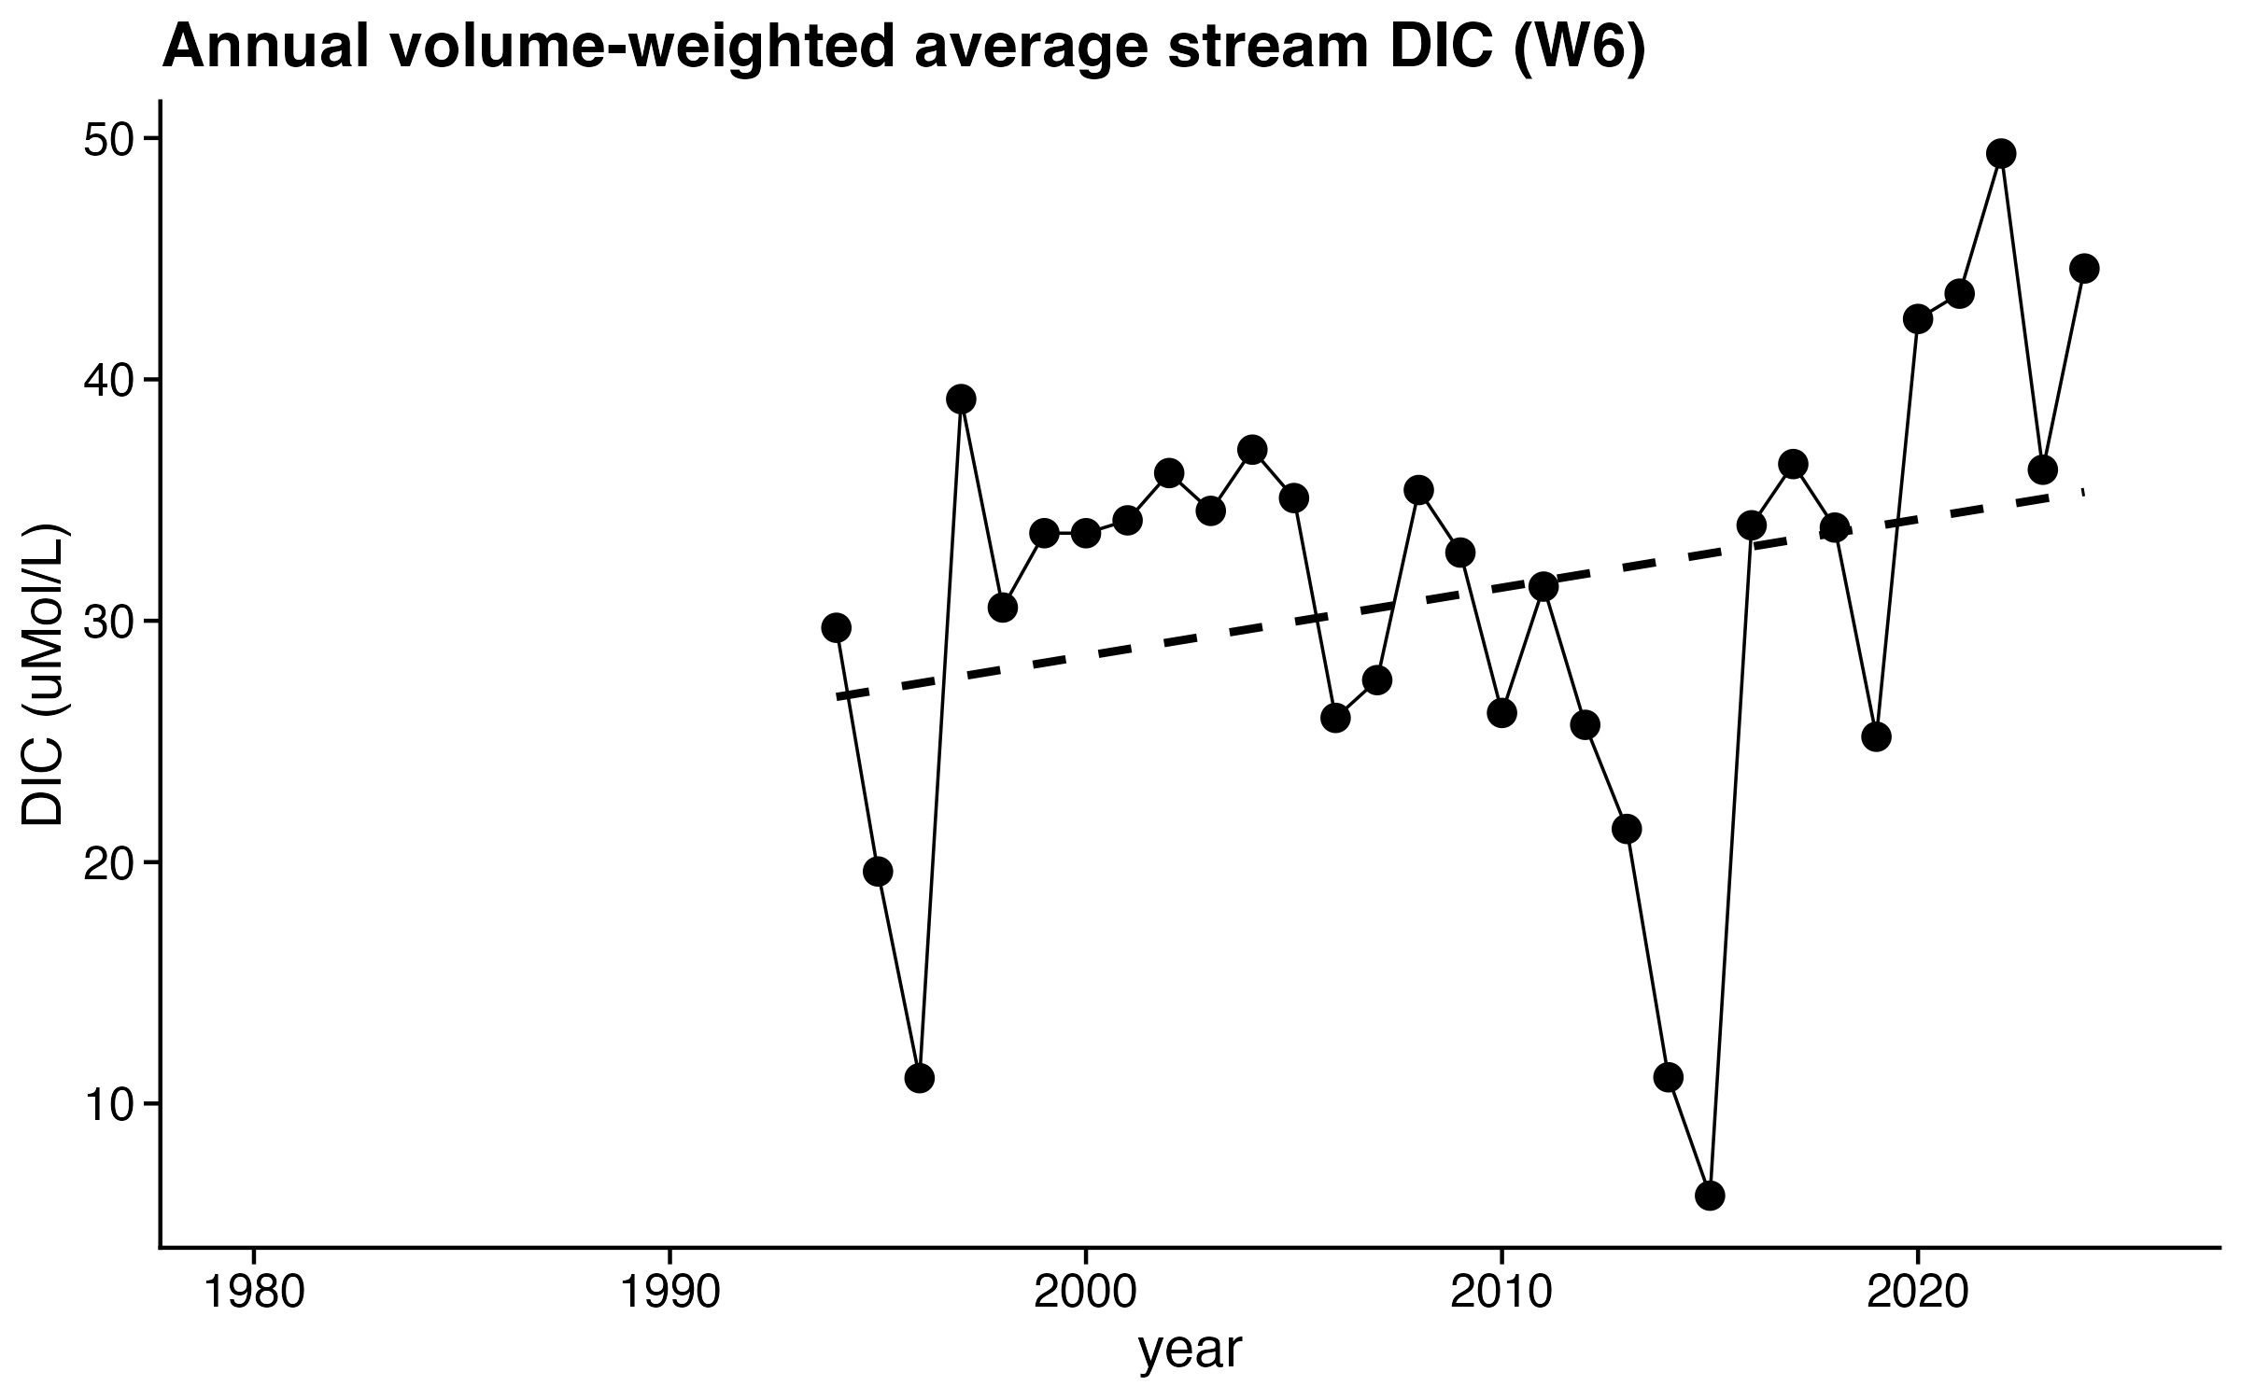
Stream Response
Slope = NS
Standardized slope = NS

Slide 12

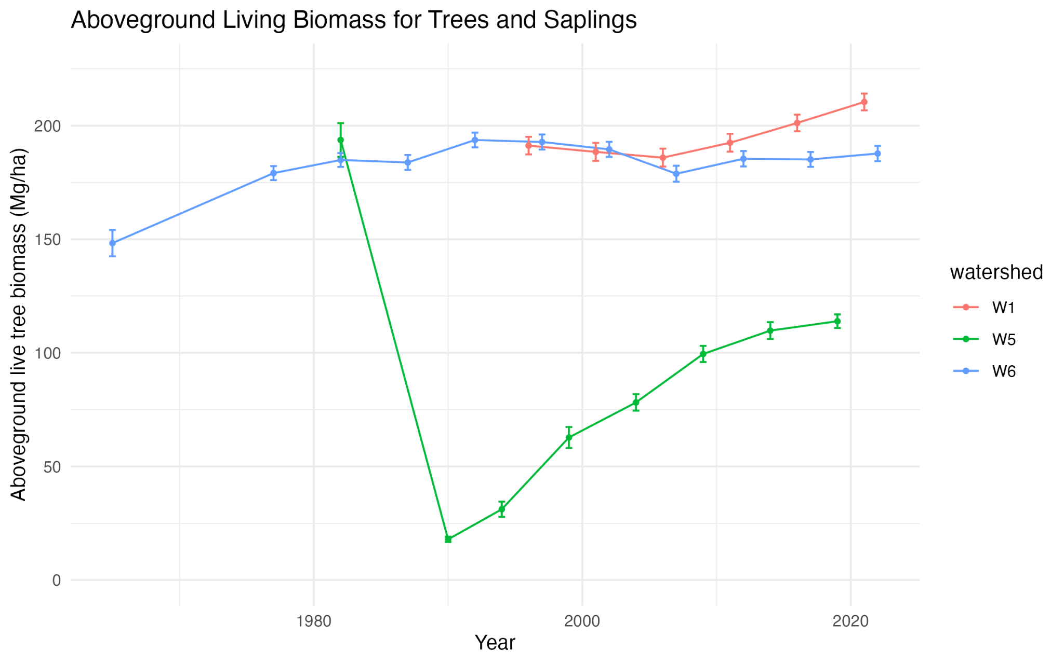
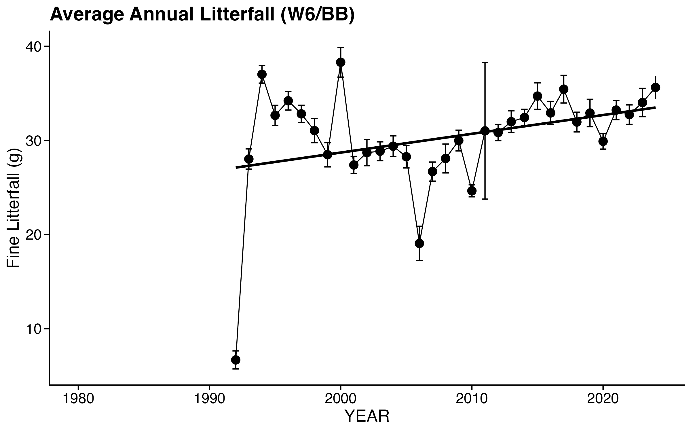
Plant Response
Slope = 0.1994 g year⁻¹
Standardized slope = 0.3406

Slide 13

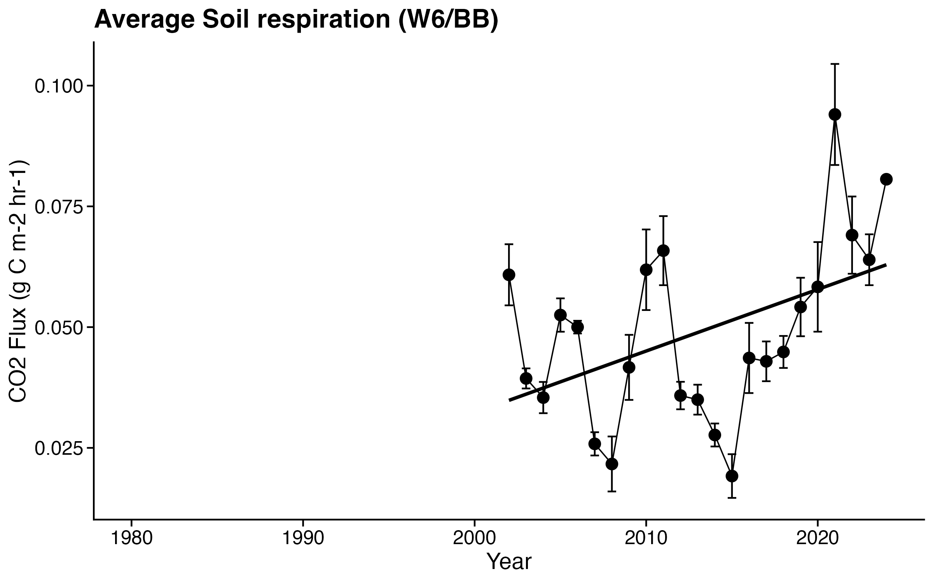
Soil Response
Slope = 0.00128 g C m⁻² hr⁻¹ year⁻¹
Standardized slope = 0.4601

Slide 14
Preliminary Conclusions
While not necessarily linear, almost all carbon flux-related parameters examined so far are increasing with similar standardized slopes
Carbon data is relatively new by Hubbard Brook standards, so we only have about 20 years where all the data overlap
There are strange values in some datasets, so expert review will be needed prior to standardized analyses
Interested in participating? Thoughts? Concerns?
Please contact me: caitlin.hicks.pries@dartmouth.edu

